Slide 1
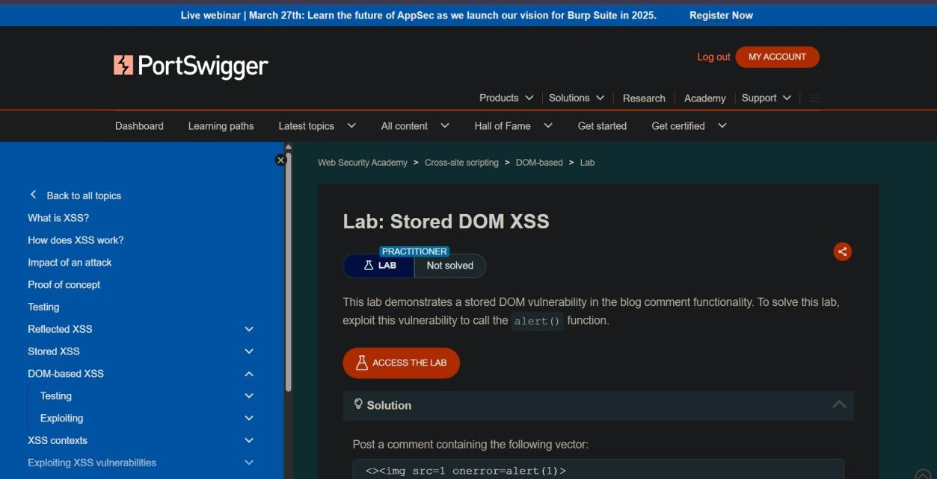
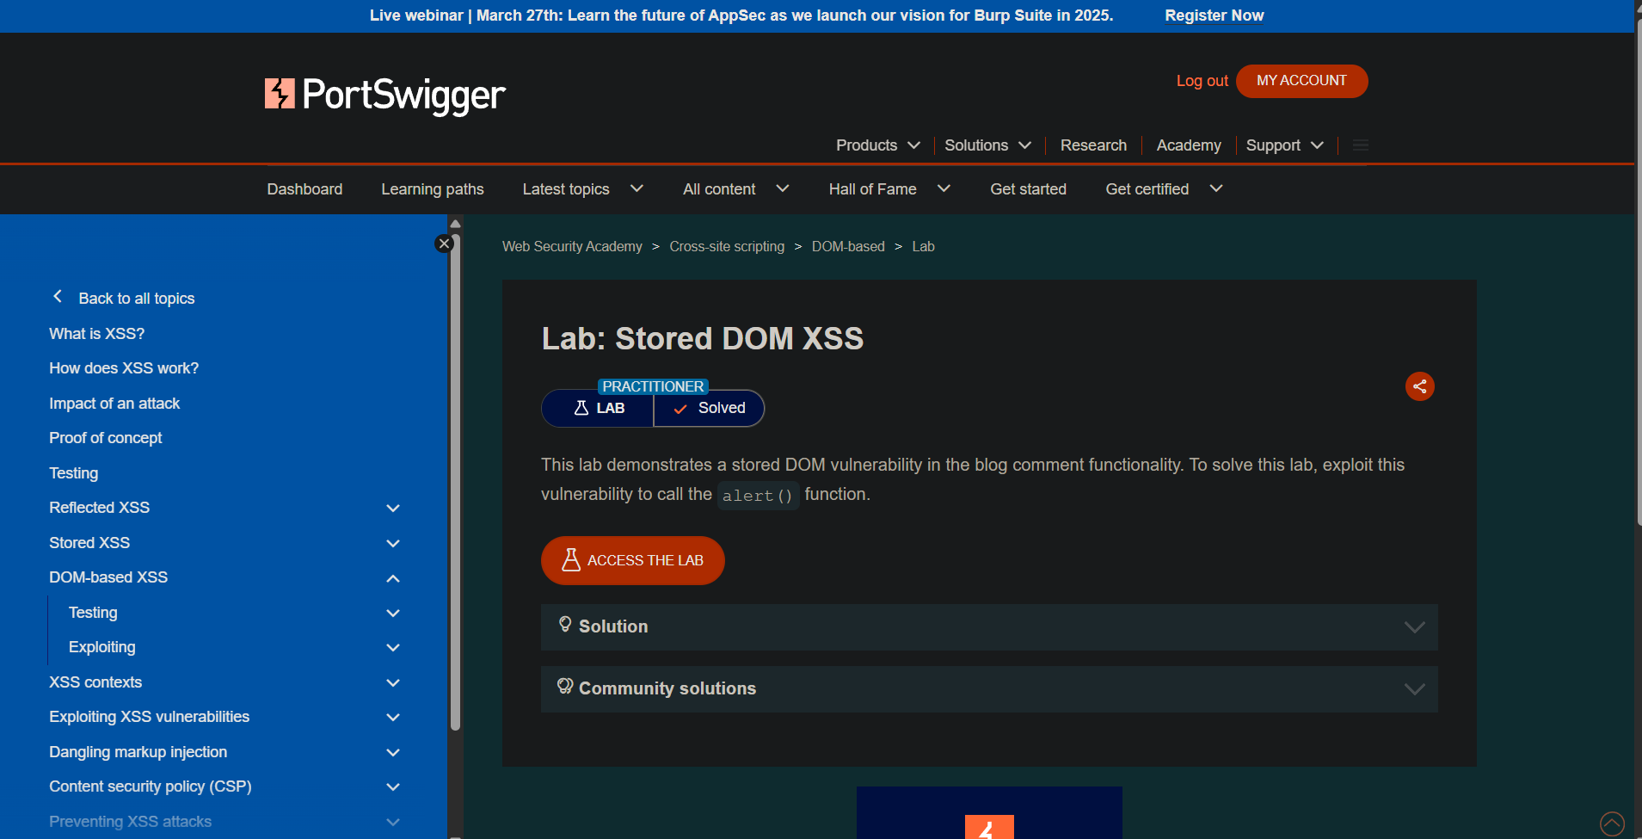
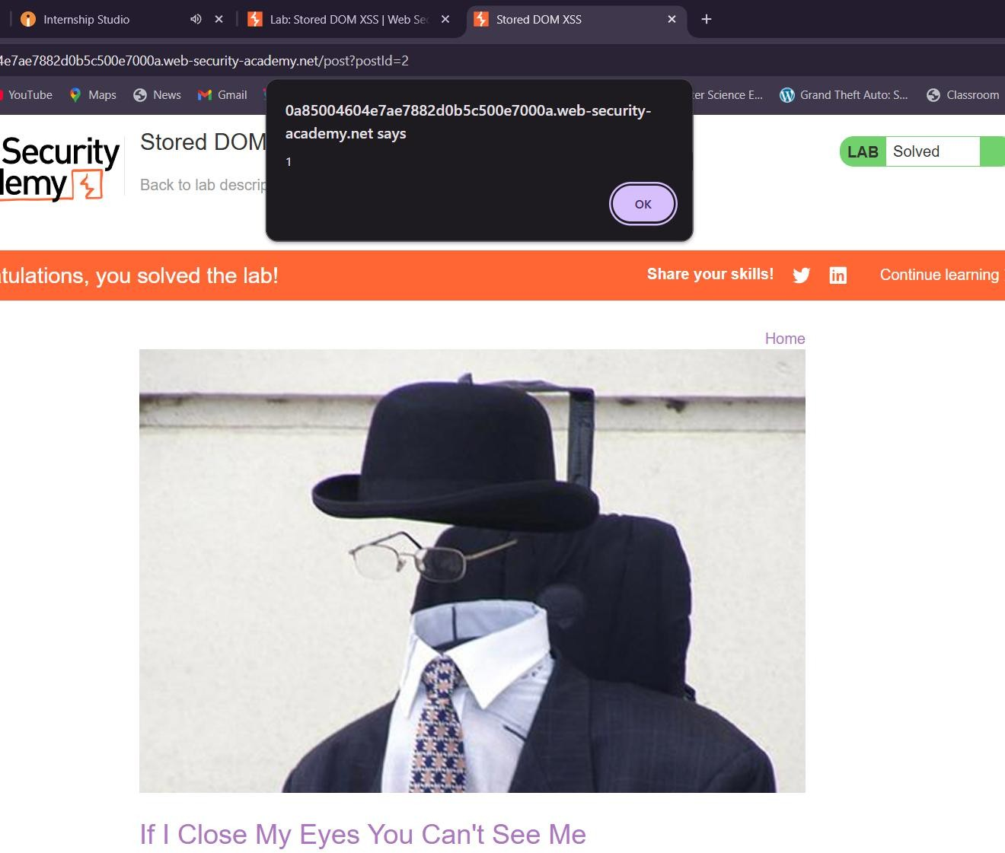
Task 1
Work Flow of XSS Attack Sample (Basic)

Slide 2
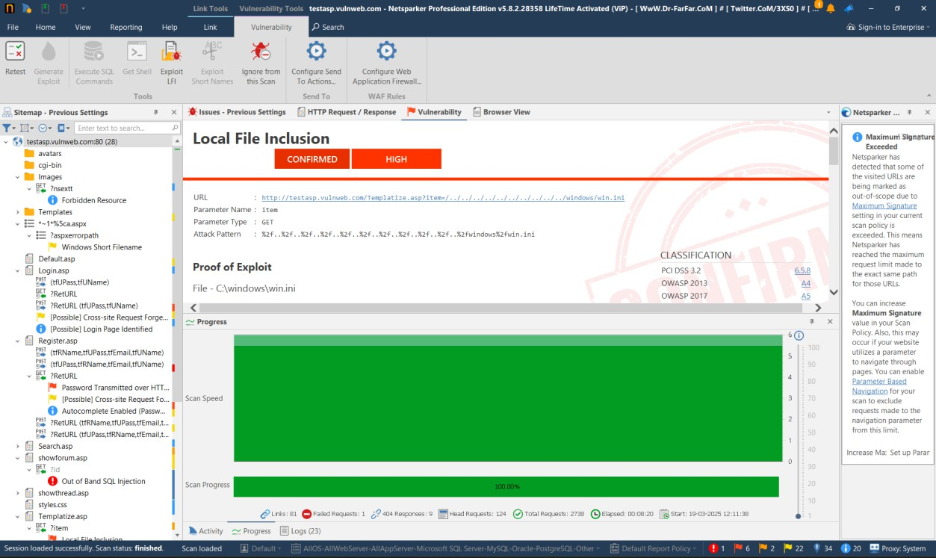
Task 2 & 3
Web Application Security Scan Report
Target: testasp.vulnweb.com
Scanner: Netsparker Scan Status: Completed Total Requests: 2738
Elapsed Time: 8m 28s
Summary of Findings Critical Vulnerabilities:
SQL Injection – High risk of database exploitation.
File Inclusion (LFI) – Possible access to sensitive system files.
Medium-Risk Issues:
Unencrypted Credentials (HTTP) – Login & registration pages transmit passwords insecurely.
Outdated IIS Server – Potential exposure to known exploits.

Slide 3
Cross-Site Request Forgery (CSRF) – Login form susceptible to CSRF attacks.
Windows Short Filename Enumeration – May reveal sensitive file paths.
Low-Risk Issues:
Cookies Not Marked as HttpOnly – Increases risk of session hijacking.
Autocomplete Enabled (Passwords) – Increases risk of phishing attacks.
Recommendations:
Fix SQL Injection using parameterized queries.
Implement HTTPS to secure user credentials.
Update IIS to a supported version.
Enforce CSRF Protections via tokens.
Secure Cookies with HttpOnly and Secure flags.

